Slide 1
Facial Recognition
Lance Pancha
Rini Jain
Rohith Rajasekaran
Kevin Jackson

Slide 2
Introduction to Facial Recognition
Facial Recognition is a type of object detection.
Facial Recognition uses the defining features of a human face to recognize them.
Further training would be needed to recognize facial expressions and or moods.

Slide 3
Modern Applications
Smartphones
Using various instruments, Smartphones use facial recognition by comparing the face trying to unlock the phone with the one(s) used during setup.
Airports
Modern Airports utilize facial recognition to reduce wait times for those who have biometric passports such as epassports allowing them to reach their gate faster as well as aid in security.
Law Enforcement
Law enforcement collects mugshots of people arrested and uses facial recognition to compare them to various databases when conducting a criminal search.

Slide 4
The Hardware
Raspberry Pi 4: As older models are likely not as powerful to handle the processing
Raspberry Pi camera module: Used to capture video to be processed
Intel Neural Compute Stick 2: Once trained the NCS2 does the bulk of the facial recognition processing

Slide 5
The Software
Raspbian Buster OS: Functions as the main operating system and is what handles all hardware
OpenCV: Will take in the images / video feed, run it through the Neural Network, and display the output passed from the Neural Network
Intel OpenVino: Through this program the Raspberry Pi interfaces with and programs the Neural Compute Stick 2.

Slide 6
Our Implementation
Install OpenVino and OpenCV
Set up the Environment Variables
Add USB Rules
Train the NCS2
Build the Program
Once the Program is built and the NCS2 is trained
Images / Video are inputted
Output images are generated and faces detected are enclosed by Magenta boxes.

Slide 7

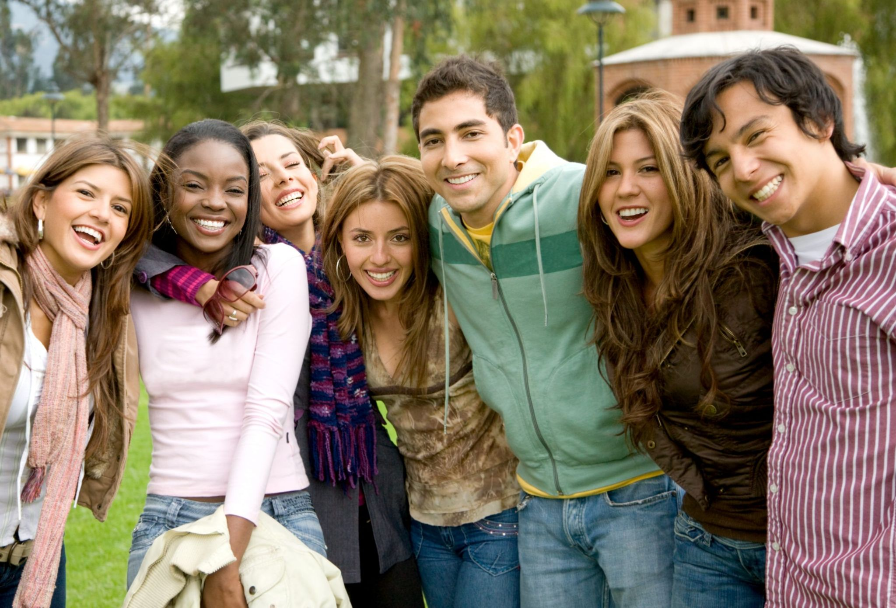
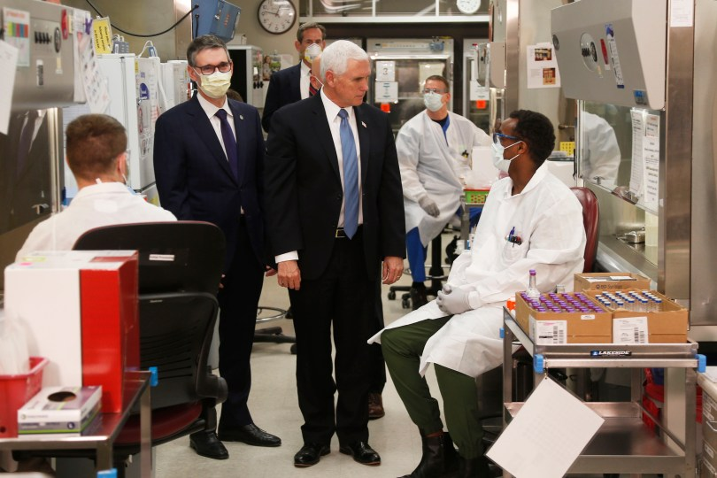
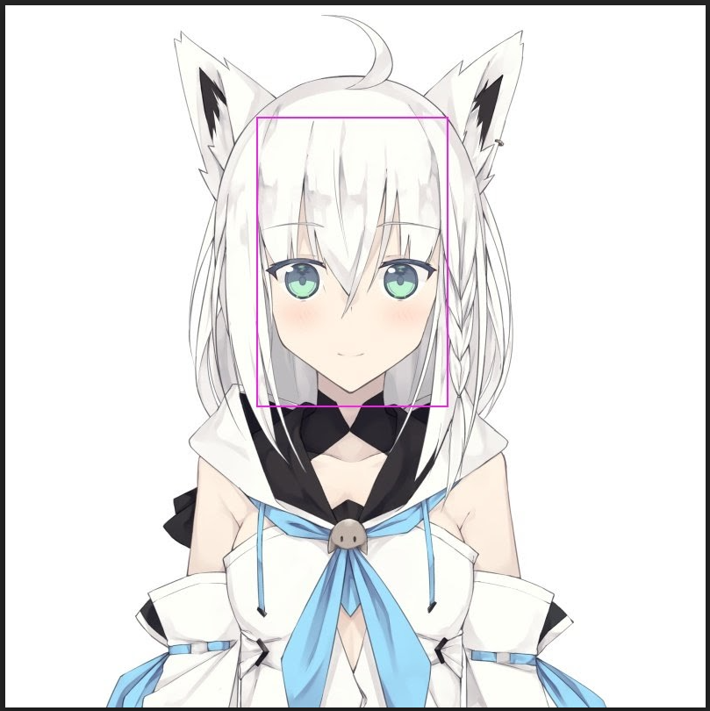
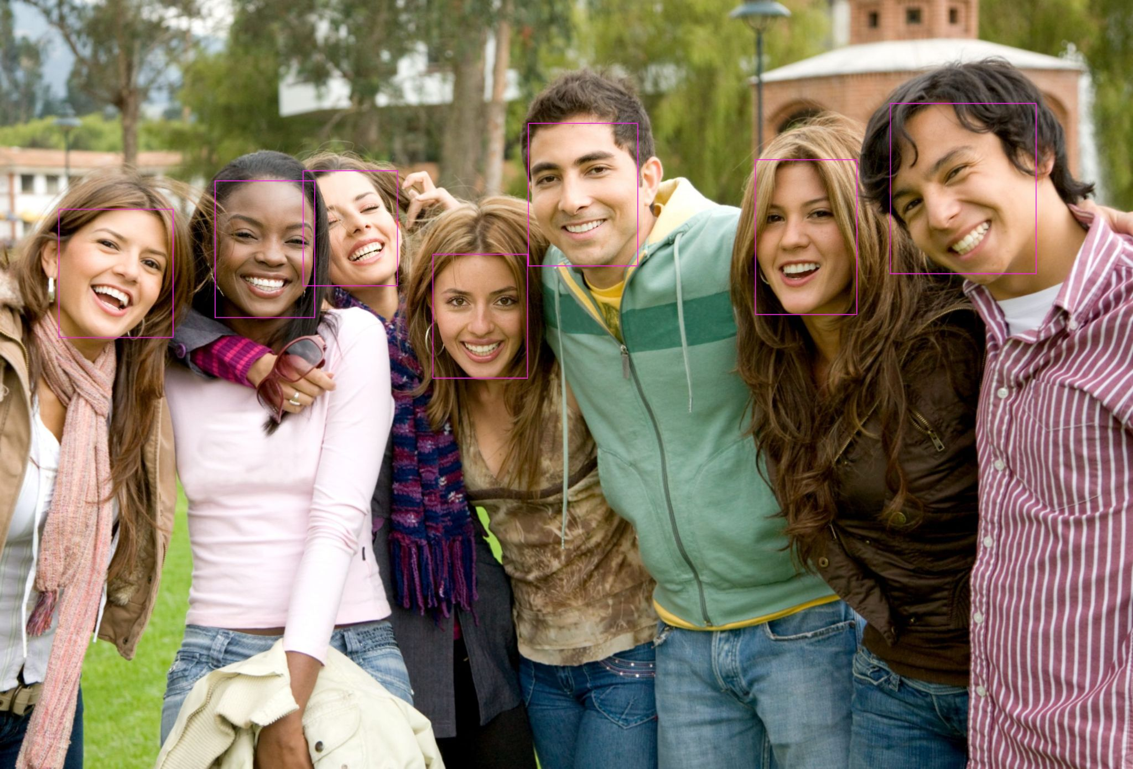

Examples

Slide 8
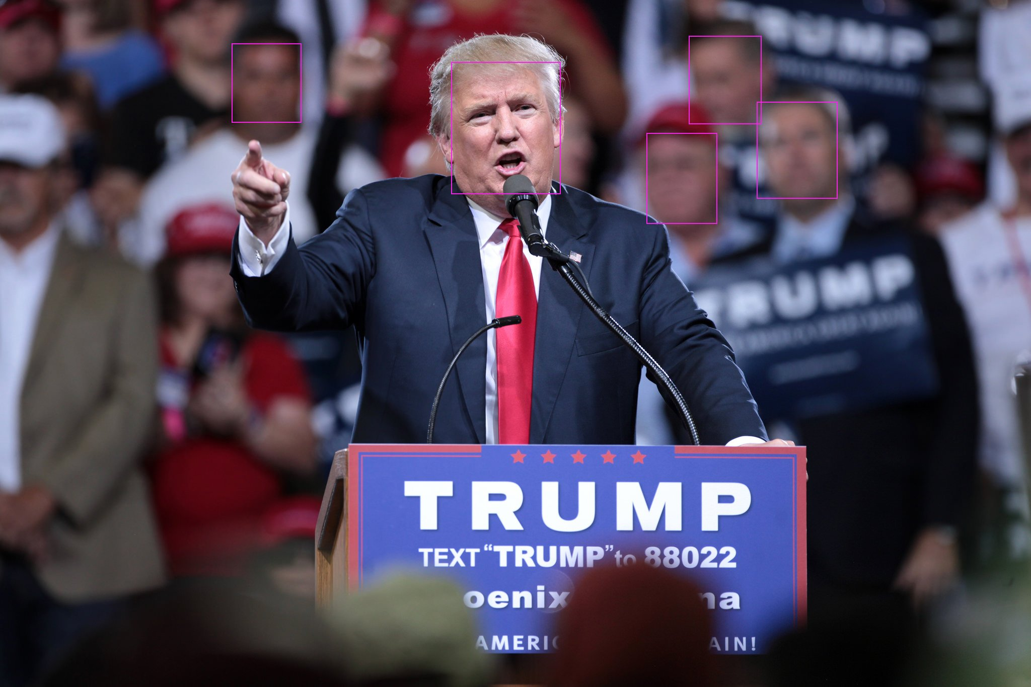

Slide 9

Demonstration:

